Slide 1

Vue.js: Bringing Ideas to Life
Discover the power of Vue.js 3.5 through practical, real-world application.

Slide 2
What is Vue.js?
Progressive Framework
Reactive & Declarative
Flexible Integration
A lightweight (~20KB) JavaScript framework for building user interfaces, designed for incremental adoption.
Features declarative rendering and a powerful reactive data binding system, simplifying UI development.
Seamlessly integrates into existing projects, supporting SPAs, SSR, SSG, and Web Components.

Slide 3




Core Features of Vue.js
Component-Based
Reactivity System
Structured with reusable Single-File Components (.vue), promoting modular and organised code.
Utilises ref() and reactive() for efficient data tracking and automatic UI updates.
Template Syntax
Composition API
Intuitive template syntax with directives like v-for, v-if, and @click for dynamic content.
Enables modular and reusable logic, enhancing code organisation and scalability, especially for larger applications.

Slide 4
The Vue.js Ecosystem in 2025
Vue 3.5: Stability & Speed
Vite: Blazing Fast Builds
Latest stable release with improved Composition API.
Default build tool for rapid development server starts and hot module replacement.
Enhanced performance and developer experience.
Optimises build processes for production deployments.
Pinia: State Management
Key Libraries & Tools
Official, lightweight state management solution.
Replaces Vuex for most new projects, offering better TypeScript support.
Vue Router for navigation.
Vue Test Utils for robust testing.
Devtools for in-browser debugging and inspection.

Slide 5
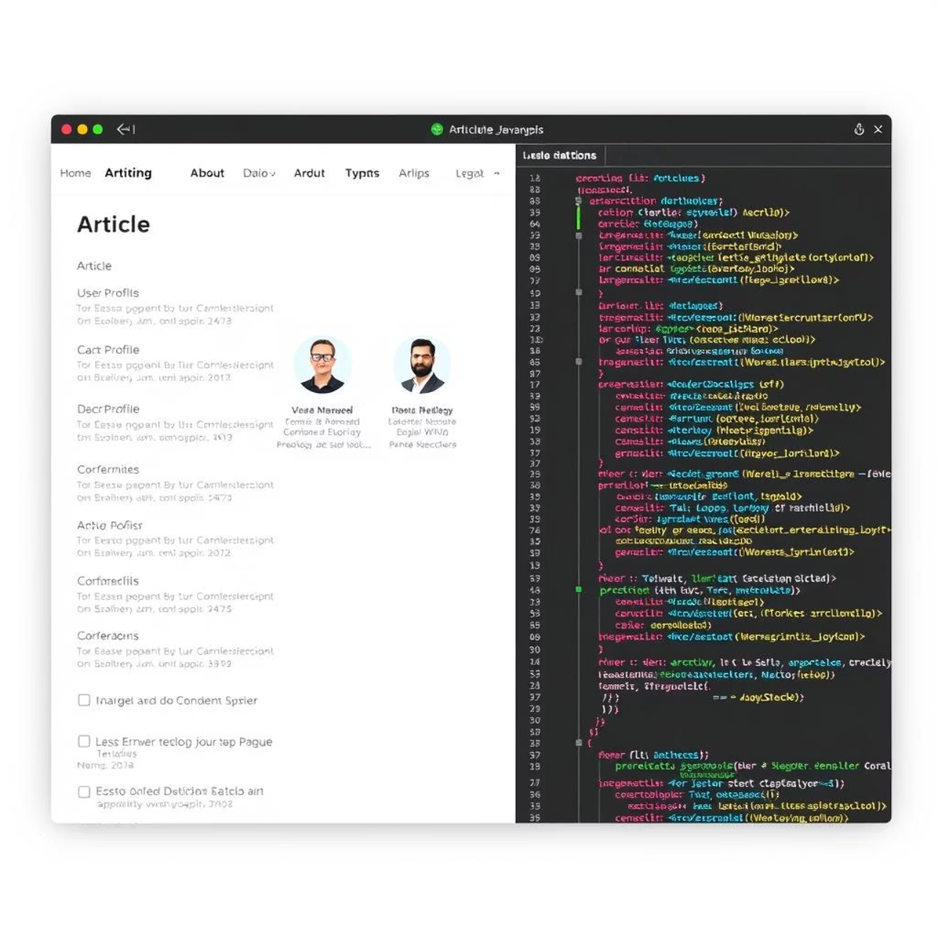
Introducing the RealWorld Vue.js App
The RealWorld application is an open-source, full-stack demonstration of Vue.js best practices.
Features: Create, Read, Update, Delete (CRUD) operations, user authentication, routing, and pagination.
Utilises either Vuex (for legacy projects) or the more modern Pinia for state management.
Acts as a blueprint for scalable Vue.js applications.
Explore the live demo here.

Slide 6




RealWorld App: Architecture Overview
State Management
Routing
Modular Vuex or Pinia stores manage application state, ensuring data consistency and predictability.
Vue Router handles dynamic navigation and implements route guards for protected paths.
API Communication
Component Naming
Axios facilitates efficient and secure HTTP requests to the RealWorld backend API, managing data flow.
All application components are logically prefixed with 'rwv' for clarity and easy identification.

Slide 7
RealWorld Example: Key Code Snippets
See how reactive data, template binding, and authentication are implemented:
Reactive Data
Dynamic Navigation
Navigation menus dynamically update active states using the Composition API.
const count = ref(0);
Template Binding
Authentication Flow
Robust authentication with token storage and route guards to protect sensitive areas.
<button @click="count++">Count: {{ count }}</button>

Slide 8
Best Practices Demonstrated
Strict adherence to the Vue Style Guide (Priority A & B rules) for consistent and maintainable code.
Comprehensive use of unit and end-to-end testing with Vue Test Utils to ensure reliability.
Effective modularisation of features using the Composition API and Pinia stores.
Optimised performance through lazy loading and efficient component rendering.
Clear separation of concerns between UI, logic, and state management.

